Slide 1
Computer Architecture
Atul Kahate

Slide 2
Number Systems and Data Representation

Slide 3
Number Systems
We work with decimal numbers (0-9)
Modern computers do not work with decimal numbers – they use binary numbers (0-1)
Why? Because electronic devices are most reliable when designed for two-state (binary) operations

Slide 4
Decimal Odometer
When a car is just manufactured, it has run 0 kilometers
Hence its odometer shows 00000
After running for 1 kilometer, the odometer shows 00001
This goes on up to 00009
After 10 kilometers are complete, the units wheel turns back from 9 to 0 and a tab on this wheel forces the tens wheel to advance by 1, so we now have 00010

Slide 5
Reset and Carry
What has happened?
The units wheel has reset to 0 and has sent a carry to the tens wheel
This action can be called as reset and carry
The other wheels also reset and carry
After 999 kilometers, the odometer shows 00999
After 1 more kilometer, the unit wheel resets and carries, the tens wheel resets and carries, the hundreds wheel resets and carries, and the thousands wheel advances by 1
So, after 999 kilometers, the odometer shows 01000

Slide 6
Digits
The numbers on each odometer wheel are called as digits
The decimal number system uses ten digits, 0 through 9
In a decimal odometer, each time the unit wheel runs out of digits, it resets to 0 and sends a carry to the tens wheel
When the tens wheel runs out of digits, it resets to 0 and sends a carry to the hundreds wheel
And so on …

Slide 7
Binary Odometer
Computers work with just two voltage pulse levels, say -15v and +5 v
We can codify -15v as 0 and +5v as 1
Binary means two
The binary number system uses only two digits: 0 and 1
The other digits 2-9 are not used
So, a binary odometer will only have two digits: 0 and 1
When each wheel turns, it displays 0 and then 1
Then it is back to 0 and again back to 1
And so on …

Slide 8
A Car with a Binary Odometer
Starting position
0000 Zero
After 1 kilometer
0001 One
After 2 kilometers, reset and carry of units wheel
0010 Two
After 3 kilometers
0011 Three
After 4 kilometers, reset and carry of units wheel and the second wheel; the third wheel advances by 1
0100 Four

Slide 9
A Car with a Binary Odometer
After 4 kilometers, reset and carry of units wheel and the second wheel; the third wheel advances by 1
0100 Four
Next few values
0101 Five
0110 Six
0111 Seven
After 8 kilometers, reset and carry of units wheel, the second wheel, and the third wheel; the fourth wheel advances by 1
1000 Eight

Slide 10
A Car with a Binary Odometer
After 8 kilometers, reset and carry of units wheel, the second wheel, and the third wheel; the fourth wheel advances by 1
1000 Eight
After 9 kilometers, we have
1001 Nine
After 10 kilometers, we have
1010 Ten
And so on ..

Slide 11
Binary Numbers
A binary odometer displays binary numbers, which are strings of 0s and 1s
Binary 0000 stands for decimal 0
Binary 0001 stands for decimal 1
Binary 0010 stands for decimal 2
Binary 0011 stands for decimal 3
For large decimal numbers, binary numbers are long
For example, decimal 42 in binary is 101010

Slide 12
Exercise
A binary odometer has four wheels. What are the successive binary numbers?

Slide 13
Bit
Binary Digit = Bit
A binary number 1010 has 4 bits
A binary number 100100 has 6 bits
One bit is stored in one transistor

Slide 14
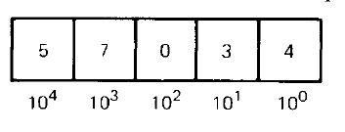
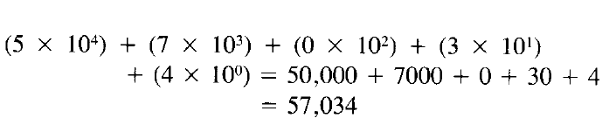
Decimal Weights
Each digit in a decimal number has a positional weight
Here, the weights are units, tens, hundreds, thousands, and so on
Sum of all the digits multiplied by their respective weights gives the total value of the number
Example: 57034 in decimal

Slide 15
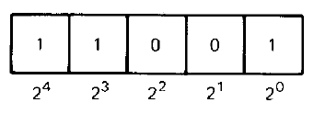
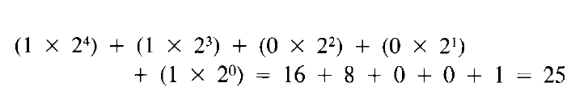
Binary Weights
Even in binary number, each bit has a positional weight
Since only two digits or bits are used, the weights are powers of 2, instead of 10
Example: 11001 in binary

Slide 16
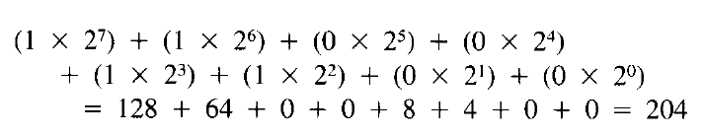
Binary to Decimal Conversion
This tells us how to convert a binary number into decimal
As another example, consider a binary number 11001100
So, binary 11001100 in decimal is 204

Slide 17
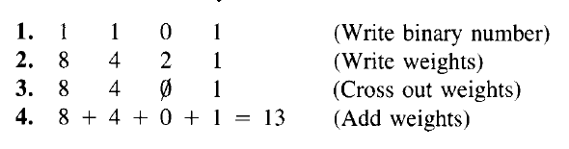
Binary to Decimal Conversion – Faster/8421 Method
Write the binary number
Write the weights 1, 2, 4, 8, 16, … under the bits from right to left
Cross out weights under a 0
Add the remaining weights
Example: Convert binary 1101 into decimal

Slide 18

Binary to Decimal – Even Shorter Method
Convert binary 1110101 in decimal

Slide 19
Base or Radix
Base or radix of a number system is equal to the number of digits it has
Decimal number system’s base is 10 (Digits 0-9 are used)
Binary number system’s base is 2 (Digits 0-1 are used)
A subscript denotes the base
Examples:
100₁₀ is decimal 100 (hundred)
100₂ is binary 100 (one zero zero)
So, we can say that 1101₂ = 13₁₀

Slide 20
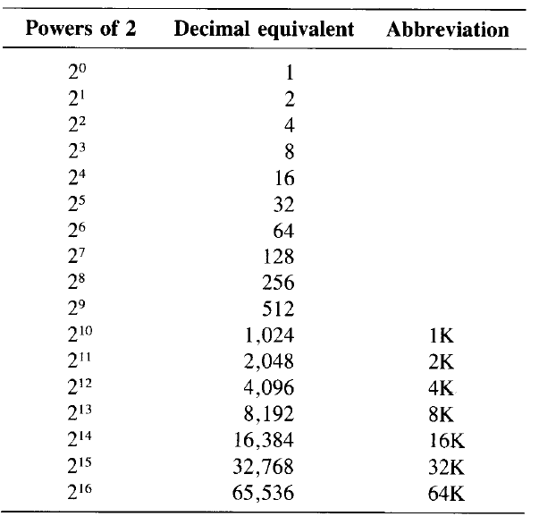
Measuring bits – the K Notation

Slide 21
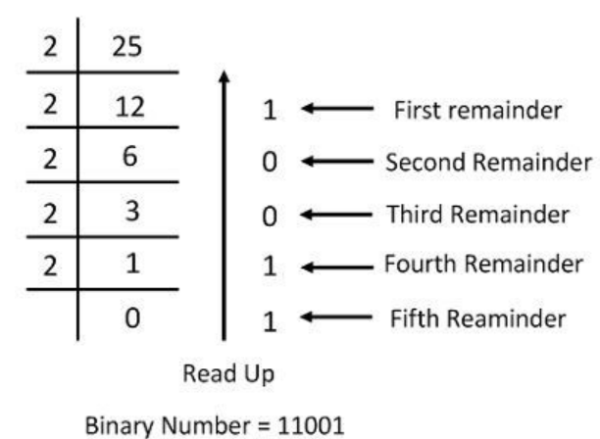
Decimal to Binary Conversion
Write the decimal number
Divide it by 2 and write the quotient and remainder
Keep doing it till we get a quotient of 0
Write the remainder in the reverse order to get the binary number

Slide 22
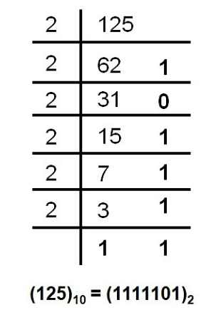
Decimal to Binary – Example
Convert decimal 125 into binary

Slide 23
Key Terminology
Bit: One single 0 or 1
Nibble: Group of 4 bits (Half-byte)
Byte: Group of 8 bits
Word: Group of 2 bytes (16 bits)
Bit
0 | 0 | 1 | 1 | 0 | 1 | 1 | 0
Byte
0 | 0 | 1 | 1 | 0 | 1 | 1 | 0
Word
Nibble

Slide 24
Hexadecimal Numbers
Hexadecimal (hex) numbers are extensively used in microprocessor work
They are much shorter than binary numbers
Hexadecimal means 16, so the hexadecimal number system has a base of 16
The 16 digits in hexadecimal number system are numbers 0 to 9 and letters A to F
In a hexadecimal odometer, each wheel will use 16 symbols to represent numbers: it will display 0 to 9 but then it will not get reset and use symbols A to F; after F it will be reset

Slide 25
Hexadecimal Odometer
0000 Zero
0001 One
0002 Two
0003 Three
…
0009 Nine
000A Ten
000B Eleven
000C Twelve
000D Thirteen
000E Fourteen
000F Fifteen

Slide 26
Hexadecimal Odometer
000F Fifteen
0010 Sixteen
0011 Seventeen
…
0019 Twenty five
001A Twenty six
001B Twenty seven
…
0020 Thirty two

Slide 27
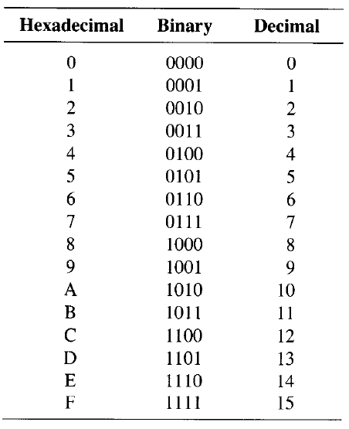
Equivalence

Slide 28
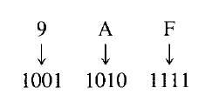
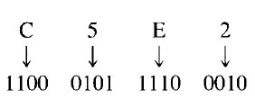
Hexadecimal to Binary Conversion
If you remember the previous table, we can simply convert each hexadecimal digit to its 4-bit binary equivalent
Examples

Slide 29
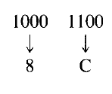
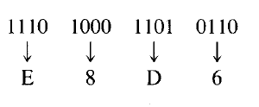
Binary to Hexadecimal Conversion
Now do the opposite!
Examples

Slide 30

Exercise
Find hexadecimal equivalent of
Find hexadecimal equivalents of

Slide 31
Exercise
Find binary equivalents of

Slide 32
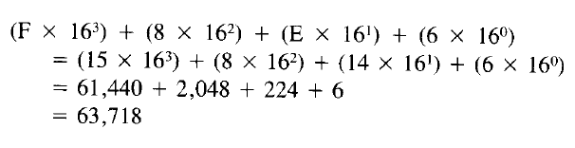
Hexadecimal to Decimal Conversion
Convert F8E6 in hexadecimal to decimal

Slide 33
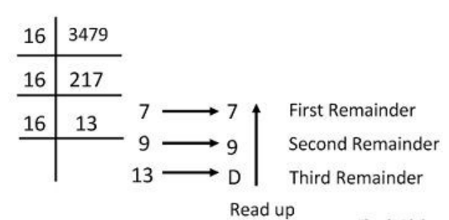
Decimal to Hexadecimal Conversion
Convert 3479 in decimal to hexadecimal

Slide 34
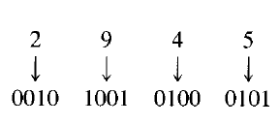
BCD Numbers
A nibble is string of four bits
Binary-coded-Decimal (BCD) numbers express each decimal digit as a nibble
Example: Decimal number 2945 in BCD is 0010 1001 0100 0101

Slide 35
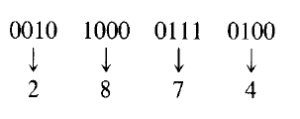
BCD to Decimal

Slide 36
The ASCII Code
Computers deal with numbers, alphabets, and other symbols
American Standard Code for Information Interchange (ASCII) is a standardized 7-bit code used for this codification
Assigns a fixed code to each symbol

Slide 37
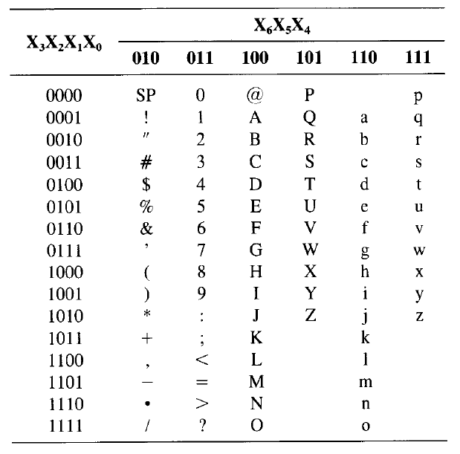
The ASCII Table
Example:
Alphabet A: 100 0001
Number 5: 011 0101

Slide 38
Unicode
Unicode is a universal character encoding standard
This standard includes roughly 100000 characters to represent characters of different languages
While ASCII uses only 1 byte the Unicode uses 4 bytes to represent characters
Hence, it provides a very wide variety of encoding

Slide 39
Logic Gates

Slide 40
Boolean Algebra
In 1854, George Boole invented symbolic logic, now called as Boolean Algebra to complete the missing link between mathematics and logic
This is the basis for a logic gate, an electronic circuit that has one or more input signals but only one output signal
They are the fundamental components of a digital computer

Slide 41

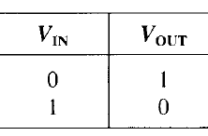
Inverter
Has only one input and only one output
The output is the inverse/opposite of the input, hence called as inverter
Creates a NOT gate (because the output is not the same as the input)
Sometimes, the output is called as the complement of the input
Symbol and Truth table

Slide 42


Boolean Algebra – Inverter (NOT Gate)
In Boolean algebra, a variable can be either a 0 or a 1.
Consider an inverter (NOT gate)
Y = NOT A, written as
If A = 0, Y = NOT 0 = 1
If A = 1, Y = NOT 1 = 0

Slide 43
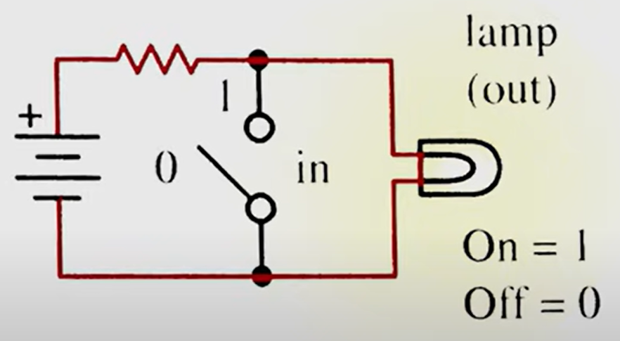
Boolean Algebra – Inverter (NOT Gate)
Basic circuit – Use on the next slide

Slide 44
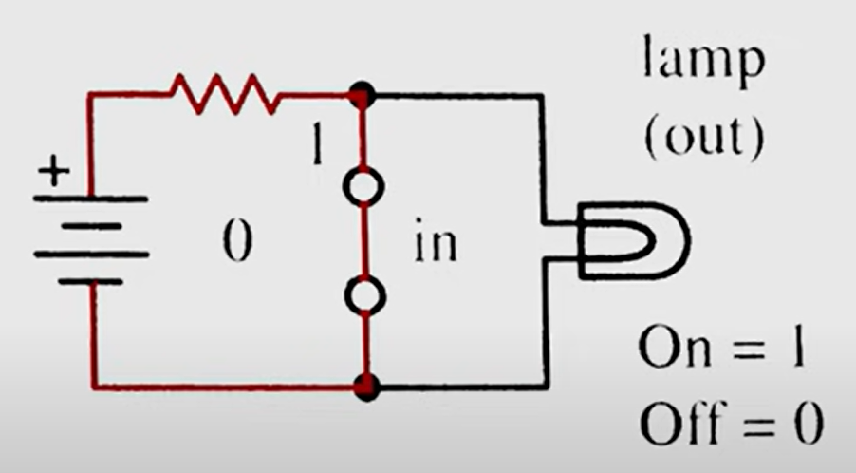
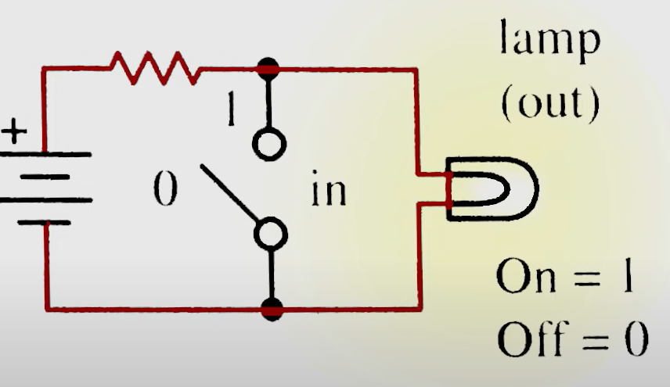
Boolean Algebra – Inverter (NOT Gate)
When input is 1, switch is closed, output is 0
When input is 0, output is 1

Slide 45

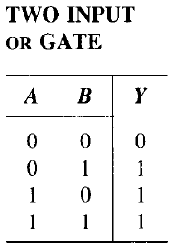
OR Gate
Has two or more inputs but only one output
If any input is high, the output is high

Slide 46
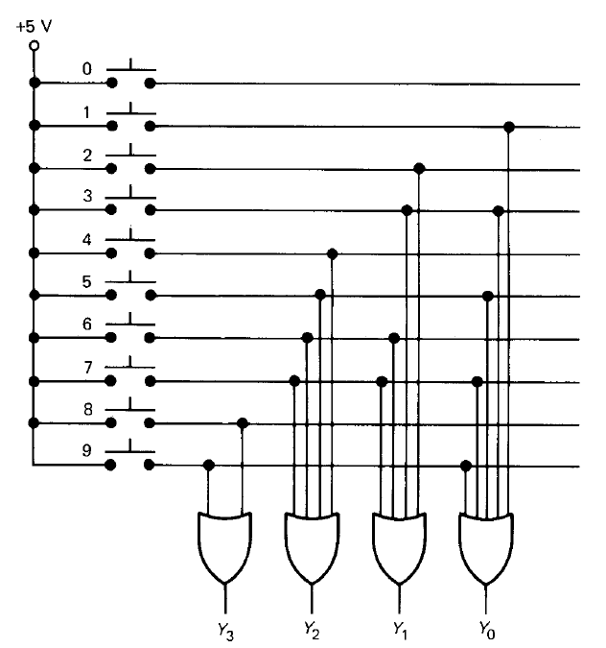
Decimal to Binary Encoder using OR Gates

Slide 47

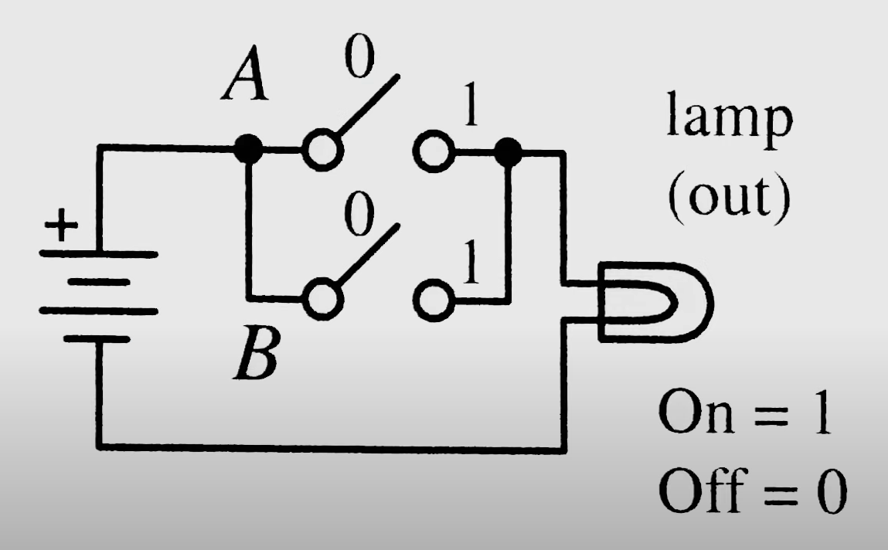
Boolean Algebra – OR Gate Operations
Consider an OR gate
We write Y = A OR B
If A = 0, B = 0, Y = 0 OR 0 = 0
If A = 0, B = 1, Y = 0 OR 1 = 1
If A = 1, B = 0, Y = 1 OR 0 = 1
If A = 1, B = 1, Y = 1 OR 1 = 1
In Boolean algebra, we use the + sign to indicate an OR operation
So, Y = A OR B, i.e. Y = A + B (read as Y equals A OR B)

Slide 48
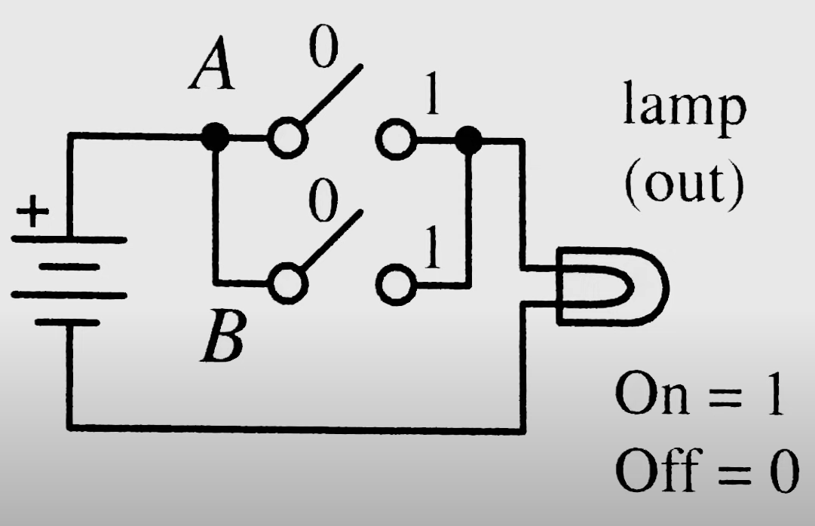
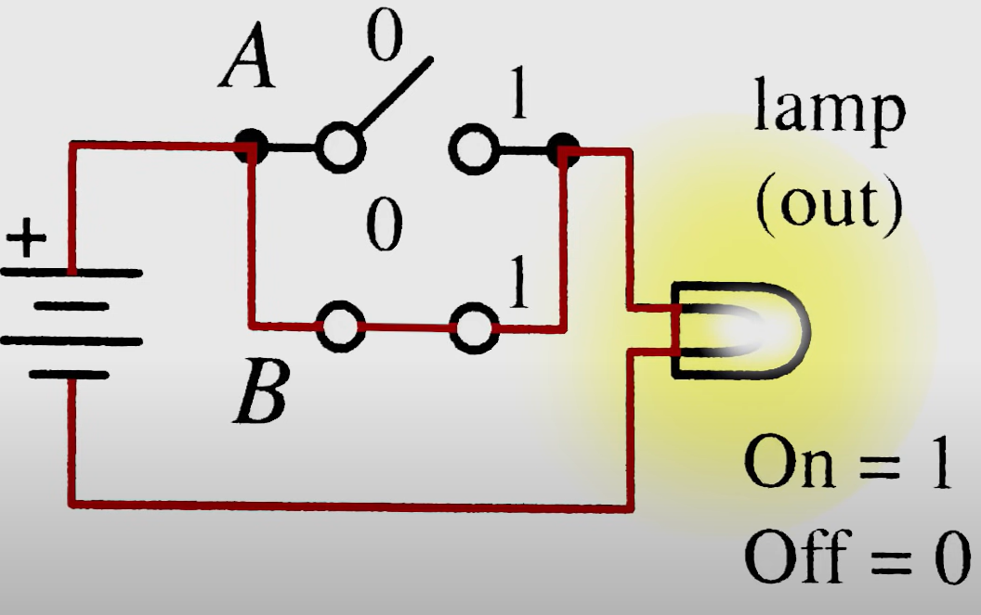
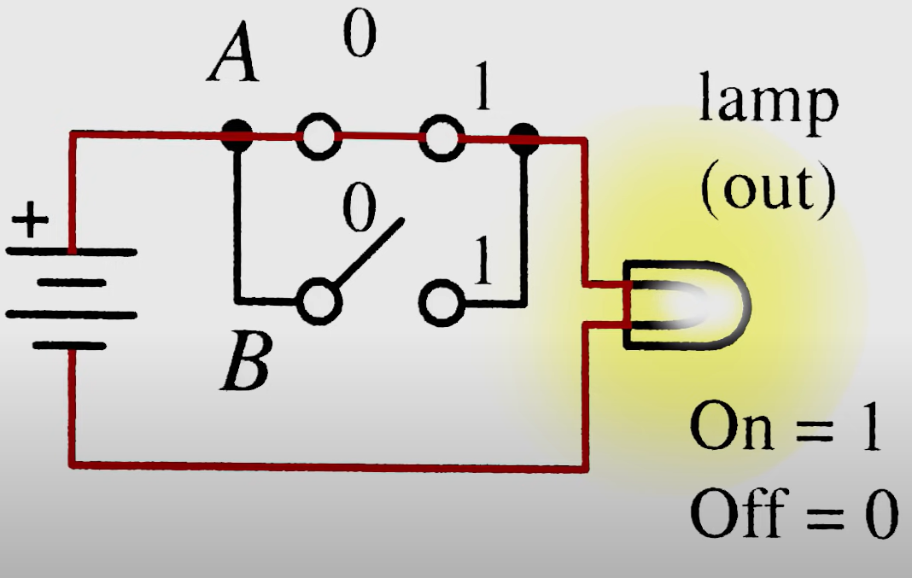
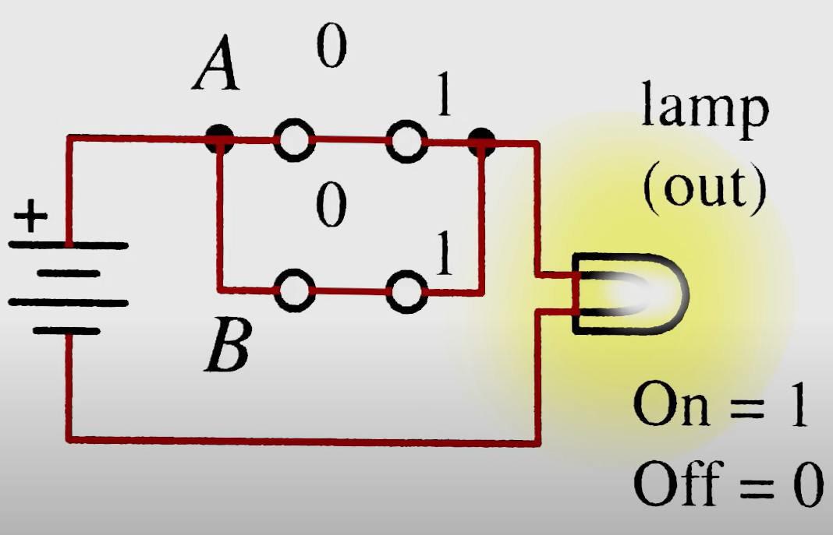
OR Gate Operations

Slide 49
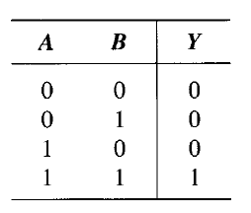
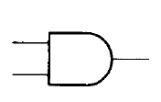
AND Gates
Has two or more inputs, but only one output
All inputs must be high to get a high output

Slide 50

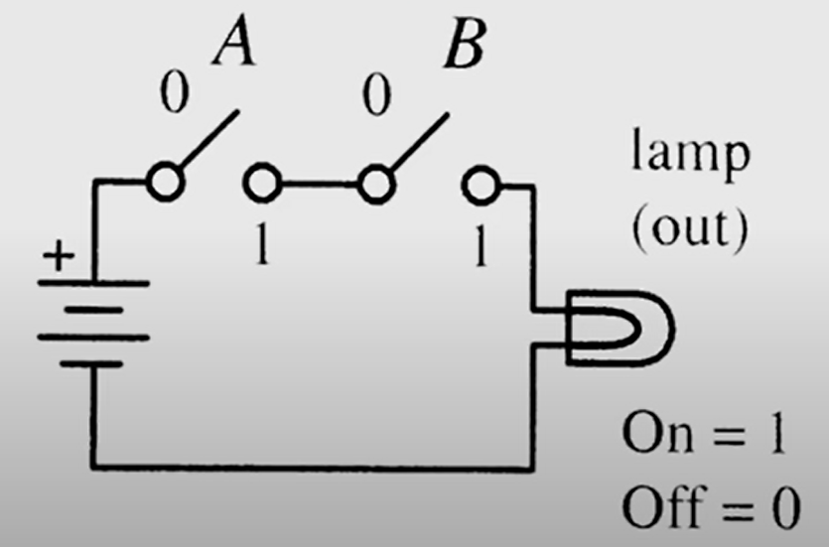
Boolean Algebra – AND Gate Operations
Consider an AND gate
We write Y = A AND B
If A = 0, B = 0, Y = 0 AND 0 = 0
If A = 0, B = 1, Y = 0 AND 1 = 0
If A = 1, B = 0, Y = 1 AND 0 = 0
If A = 1, B = 1, Y = 1 AND 1 = 1
In Boolean algebra, we use the multiplication (x) sign to indicate an AND operation
So, Y = A AND B, i.e. Y = A x B (read as Y equals A AND B)

Slide 51
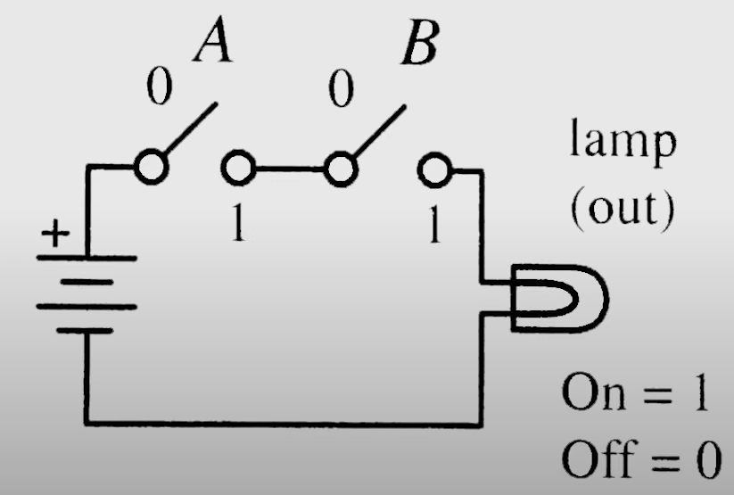
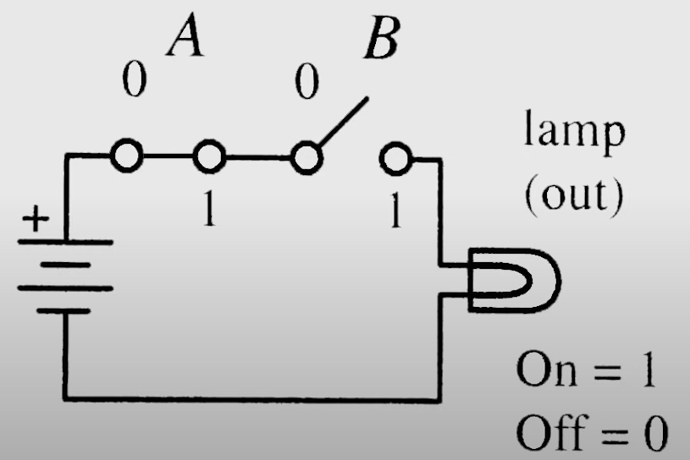
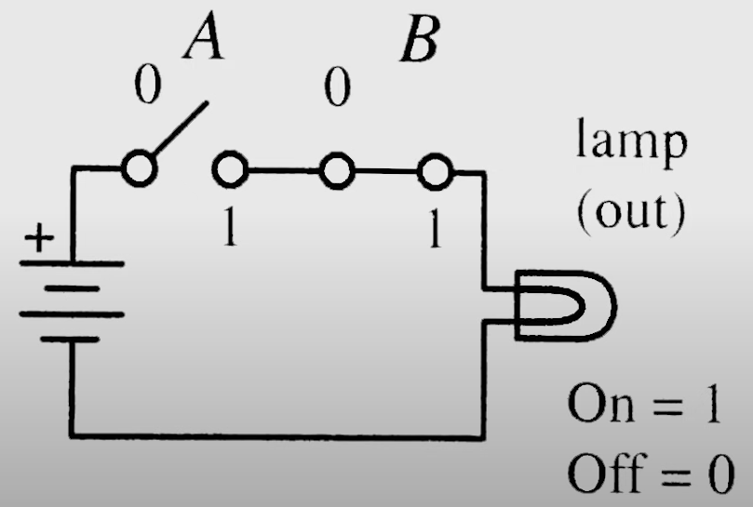
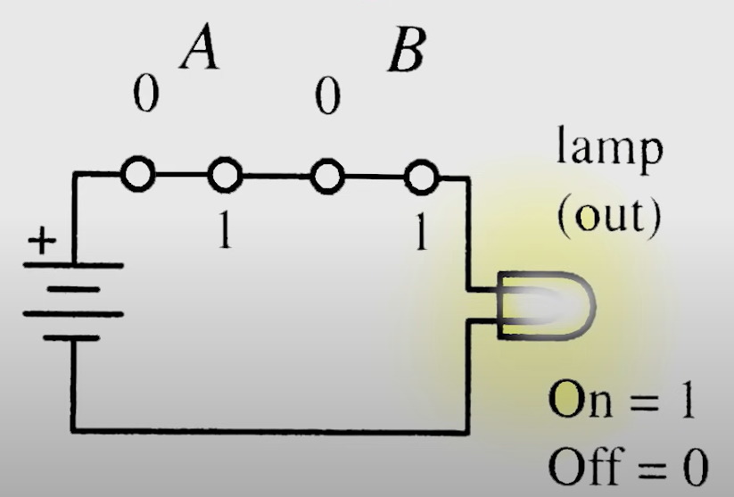
AND Gate Operation – Four Cases

Slide 52
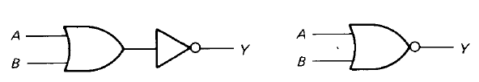
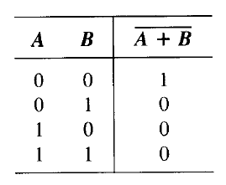
NOR Gate
It is the opposite of OR gate
All the inputs to a NOR gate must be low to get a high output

Slide 53

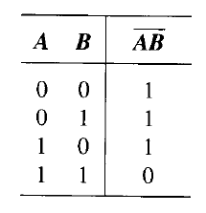
NAND Gate
It is the opposite of AND gate
All the inputs to a NOR gate must be high to get a low output

Slide 54
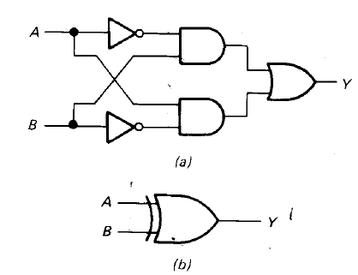
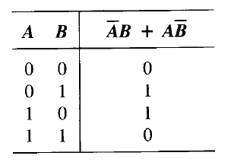
XOR Gate
Only if we have an odd number of high inputs, the output is high

Slide 55
Circuit Design using Logisim
Refer to a separate PPT

Slide 56
Binary Arithmetic

Slide 57
Binary Addition
Rules of binary addition
0 + 0 =0
0 + 1 = 1
1 + 0 = 1
1 + 1 = 10
1 + 1 + 1 = 11

Slide 58
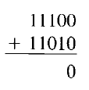
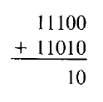
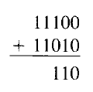
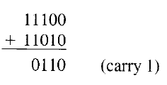
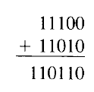
Binary Addition Example
Add two binary numbers: 11100 and 11010
Here, 1 + 1 + 1 (carry) produces 11, recorded as 1 with a carry of 1 to the next higher column

Slide 59
Binary Subtraction
Rules of binary subtraction
0 – 0 = 0
1 – 0 = 1
1 – 1 = 0
10 – 1 = 1

Slide 60
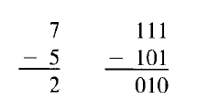
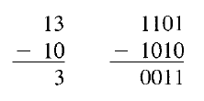
Binary Subtraction Example
Computers use different techniques for binary subtraction, as we will discuss soon

